Slide 1
Auto Insurance Fraud Prediction
Team 10
Paige Christian, Cassie Lundberg, Yeon Kang, Rubaiya Masnun
Spring 2023 – CSC 4780 – Fundamentals of Data Science Final Project Presentation
April 20th, 2023

Slide 2

Agenda:
Data Pre-processing & Exploratory analysis
Analysis and Feature Selection
Data Info and Business Question
Model Performance
Evaluation & Conclusions

Slide 3
Data Info and Business Question

Slide 4
Data Info
Dataset:
Obtained from Kaggle
The dataset contains about 1000 records, presents information of policyholders, their vehicle information, and the details of their insurance claims.
Business Question:
"What are the common indicators of fraudulent insurance claims and how can we use this to devise a risk assessment to account for this?"

Slide 5
Data Pre-processing & Exploratory Analysis

Slide 6
Feature Determination & Handling
Removed missing values
Removed the date features (bind date and incident date), since they are irrelevant in detecting fraud
Observed the domains of each feature
Split the features into Categorical and Continuous
22 Categorical feature
15 continuous features
Created Data Quality Reports for both Categorical and Continuous features
Notes:
Normalise the data

Slide 7
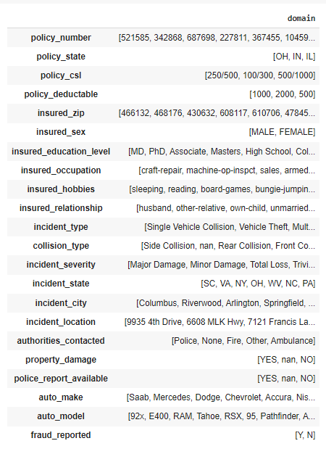
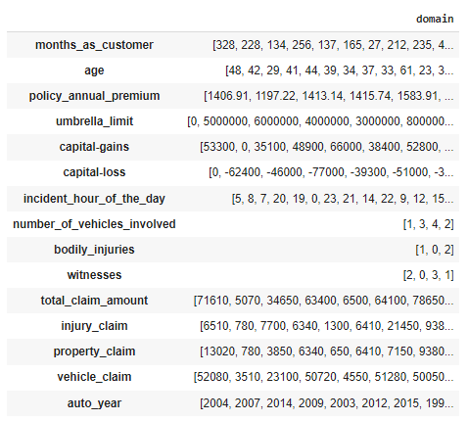
Domains
Categorical
Continuous

Slide 8
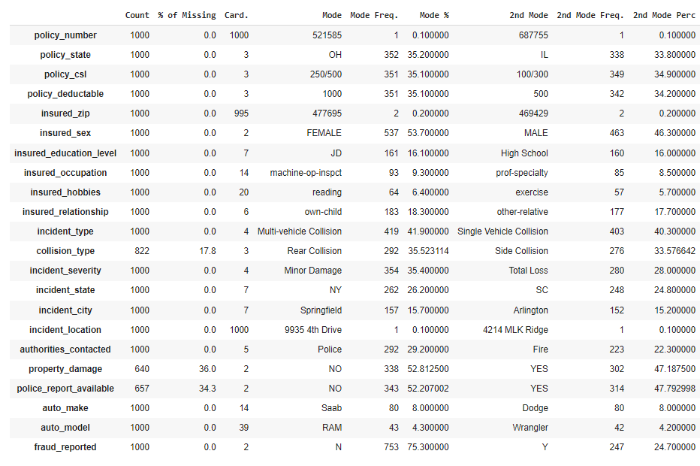
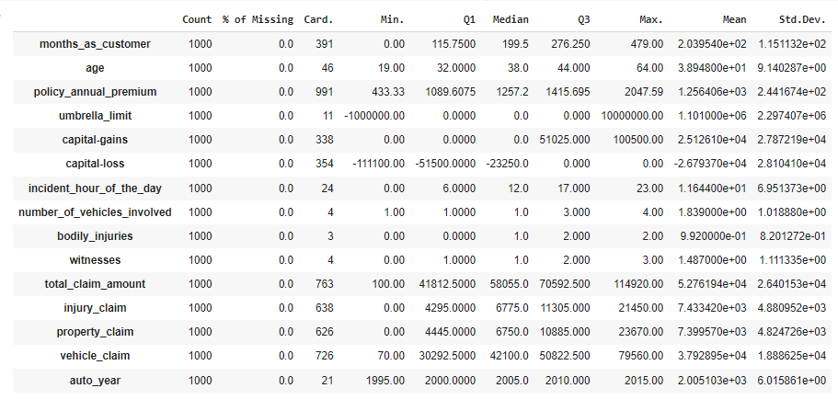
Data Quality Report
Categorical
Continuous

Slide 9
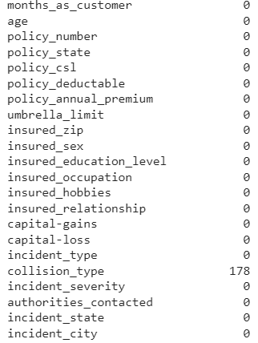
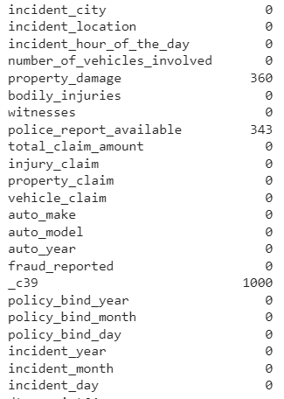
Handling Missing Data
As part of data preprocessing stage we observed null values in our dataset.
4 attributes contained null values
Dropped the _c39 column
Replaced remaining missing values with mode using mode imputation
Notes:
Notes – As part of our data preprocessing we observes if are data had missing values. Within our dataset 4 of the attributes (collision type, property damage, police report availability and _c39) as we had 1000 records and _c39 had 1000 missing we decided to drop the column entire. We then decided to replace the missing values of the other attributes with the mode so that we had good amount of records to work with for our model.

Slide 10
Analysis & Feature Selection

Slide 11
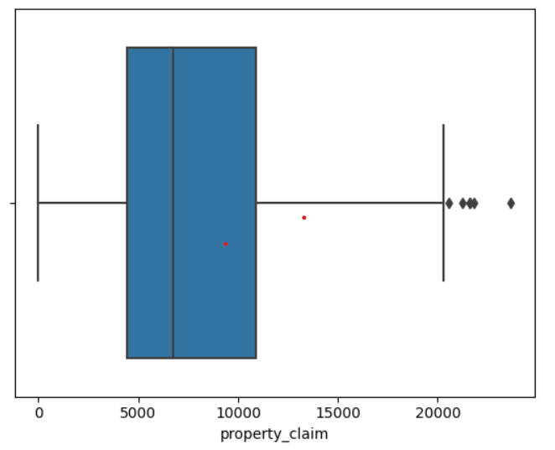
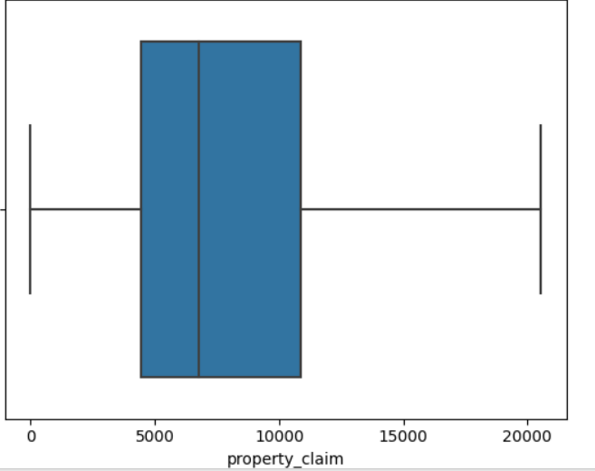
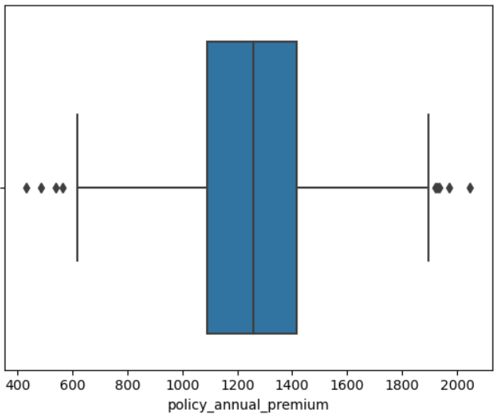
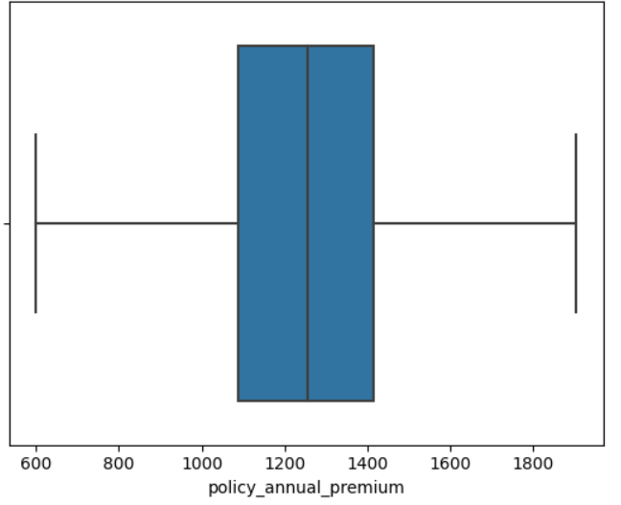
Identifying and removing outliers
Identified outliers: property claims, policy annual premium and total claim amount
Interquartile range clamp transformation
The analysis and results are based on synthetically generated data. This is NOT a reflection of Truist's data.​

Slide 12
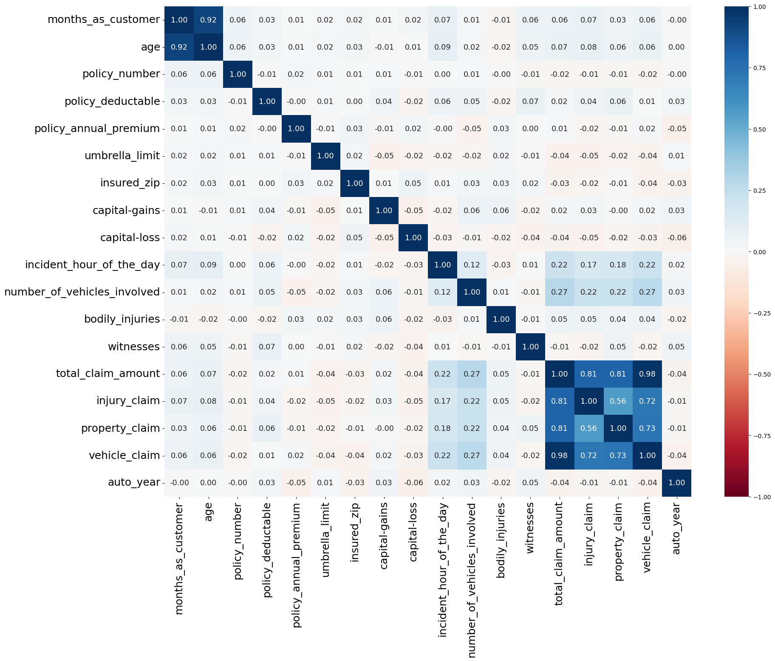
Heatmap: Continuous variable (Pearson's r)
Pearson's correlation
Scale of –1 to 1
Highly correlated features removed:
Age and months as customer
Removed 'age' as 'months as customer' related more to the business
Total claim amount with injury claim, property claim, and vehicle claim
Removed 'total claim amount' since it is the sum of all the claims

Slide 13
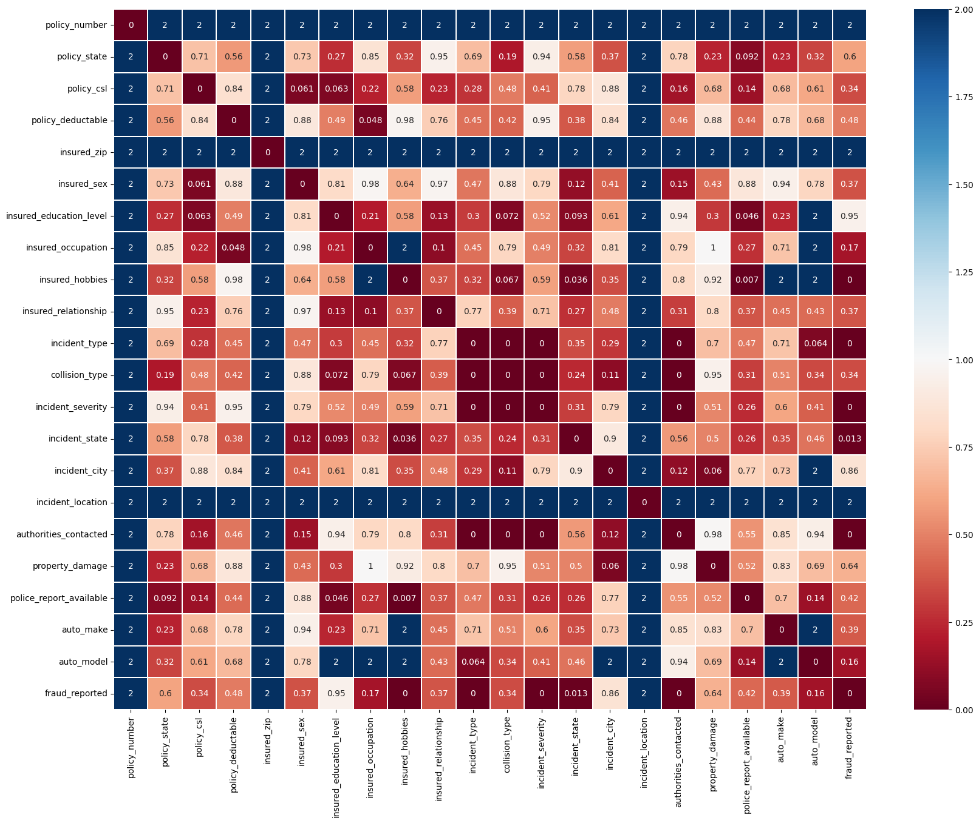
Heatmap: Categorical variable (Chi-Squared test)
P-value
Significance level = 0.05
P <0.05
Incident type, collision type, incident severity and authorities contacted
"2" indicates variables where the expected frequency is less than 20%
High cardinality
Not provide sufficient information
Removed 'policy number', 'Insured zip' and 'incident location'
Notes:
P< 0.05: sufficient evidence to conclude that the observed distribution is not the same as the expected distribution: a relationship exists between the categorical variables.
Removed variables: policy sate,

Slide 14
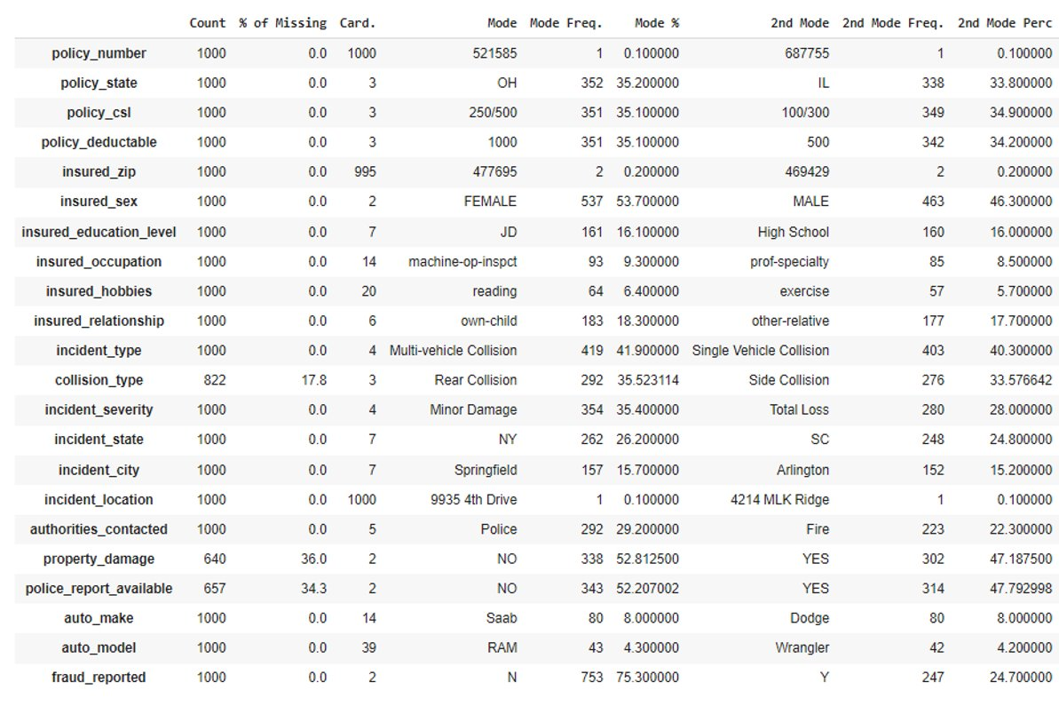
Removed Categorical variables
Removed high cardinality variables (dummy code problems)
Auto make and auto model
Insured hobbies
Notes:
P< 0.05: sufficient evidence to conclude that the observed distribution is not the same as the expected distribution: a relationship exists between the categorical variables.
Removed variables: policy sate,

Slide 15
Model Performance

Slide 16
Choosing Models
Scaled the data from –1 to 1 to prevent certain features overpowering smaller values of features
This helps in the performance of models
We utilized 6 different models:
Logistic Regression
AdaBoost Classifier
Support Vector Machine
K- Nearest Neighbors
Decision Tree Classifier
Random Forest Classifier
To evaluate each model, we permed cross validation on each model with 5 estimators to estimate how accurately each can predict
We evaluate the mean accuracy score for each model
Logistic Regression: 79%
AdaBoost: 78%
Support Vector Machine: 80%
K-Nearest Neighbors: 74%
Decision Tree: 71%
Random Forest: 78%

Slide 17
Choosing Models
Performed train test split with 80% training data and 20% testing data
Since accuracy alone cannot completely evaluate a model
Computed the accuracy score, confusion matrix, precision score, recall score, and f1-score of each model

Slide 18
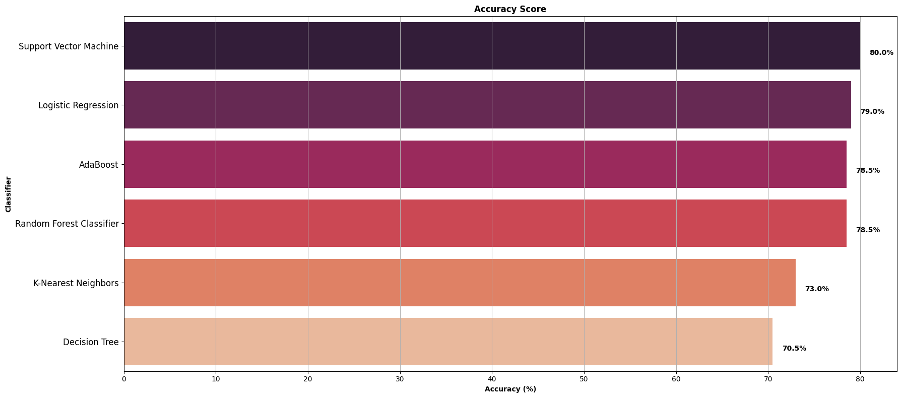
Accuracy Scores

Slide 19
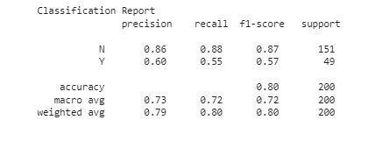
Support Vector Machine
The precision score here is showing that 60% of fraud cases are being predicted correctly and 86% of non-fraud cases are predicted correctly.
The recall score is predicting 55% of fraud cases out of the actual number of fraud cases and 88% of non-fraud cases out of the actual number of non-fraud cases
These results from SVM are the best out of all the models evaluated

Slide 20
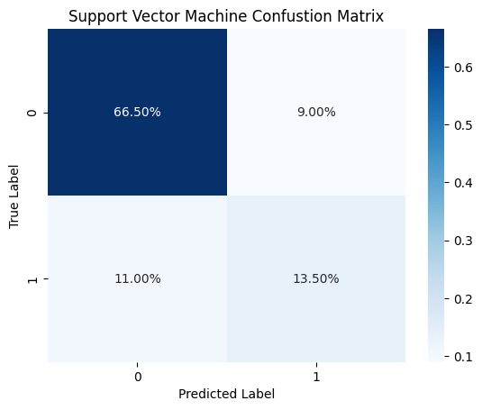
Support Vector Machine
The confusion matrix explains the percentage of predicted fraud and non-fraud cases compared to the true fraud and non-fraud cases
The diagonal of this confusion matrix is more prominent than other models as it is predicting fraud where fraud is true 13.5% and non-fraud where non-fraud is true 66.5% of the time

Slide 21
Evaluation & Conclusions

Slide 22
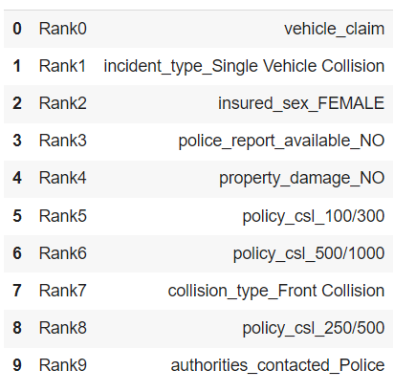
Indicators of Fraud
We used PCA ( Principle Component Analysis) to find the most important feature indicators of fraud to help with detection
These are the 10 most important features to detect fraud
The vehicle claim amount seems to be the most important deciding factor to fraudulent claims

Slide 23
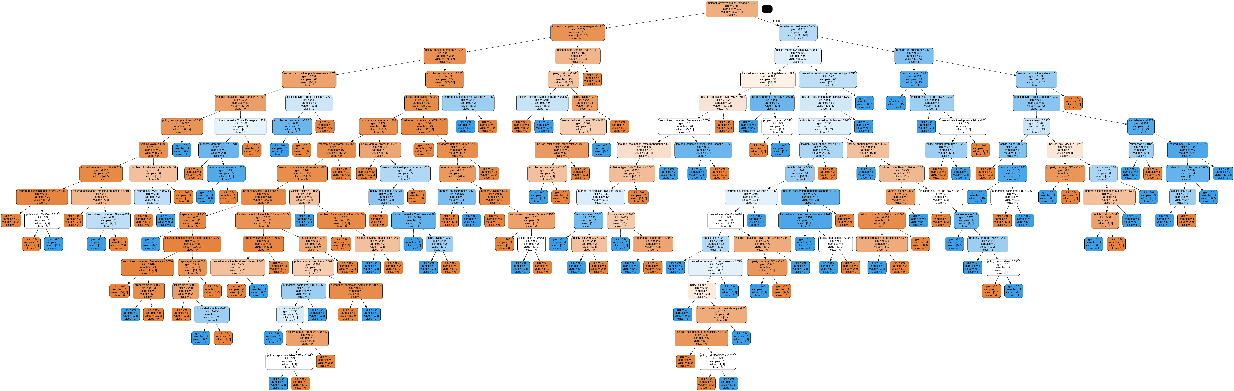
Decision Tree - Important Feature

Slide 24
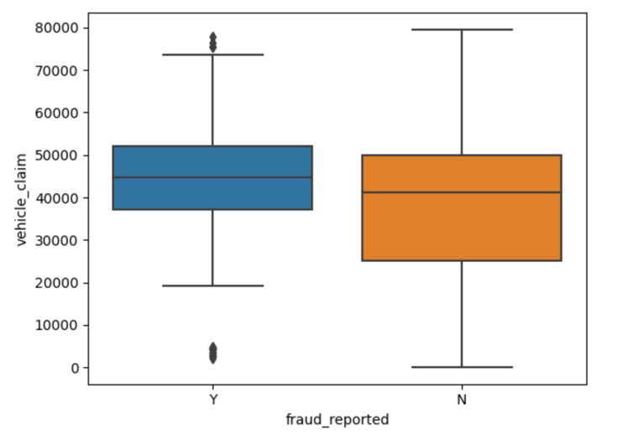
Summary
The higher the vehicle claim amount the greater the likelihood of the claim being fraudulent.
Also, single vehicle collisions, female drivers, no police report, and no property damage reported claims are likely to be fraudulent.
Concluded that Support Vector Machine was the best model for our dataset. However, a low recall and precision score for predicting fraud the model may need to be adjusted.
Notes:
Vehicle claim mean Y(43533.64), N (36090.49) Diff (7443.15)

Slide 25
Suggestions
Claims for higher amount of vehicle claims, single collisions, female drivers, no police report, and no property damage could be flagged for closer investigation as these are more likely to have fraudulent claims.

Slide 26
Questions

